Slide 1

WELCOME BACK TO
MONEY BASICS
Facilitated by:
[Facilitator 1 name]
[Facilitator 2 name]

Slide 2
Debt & Tools to Get Out of It
Workshop 7
PG. 118 IN STUDENT GUIDE

Slide 3
Welcome Back!
Updates & Sharing:
How did the money saving homework go?
How are your budgets going?
What interest rates on debts/loans did you find?
Today’s Agenda:
Identify how we feel about debt now, and how we’d like to feel in the future
Determine how much we owe and calculate our debt-to-income ratios
Learn about different methods to organize debt payoffs
Learn about bankruptcy and the pros and cons
Create an action plan for paying off debts

Slide 4
Community Agreements

Slide 5

Learning Objectives
Learning Objectives:
Upon conclusion of Workshop 7, participants will:
Have a better understanding of how personal debt affects them
Have calculated how much debt they owe and what the interest rates and actual costs are of their various debts
Have learned options and payment methods for their debt and their pros and cons
Have created a workable plan for reducing their debt

Slide 6

Thoughts on Debt
When you think about debt, what kinds of feelings does this bring up for you?
How would you like to feel about debt? Where would you like to be in one year? In three?

Slide 7
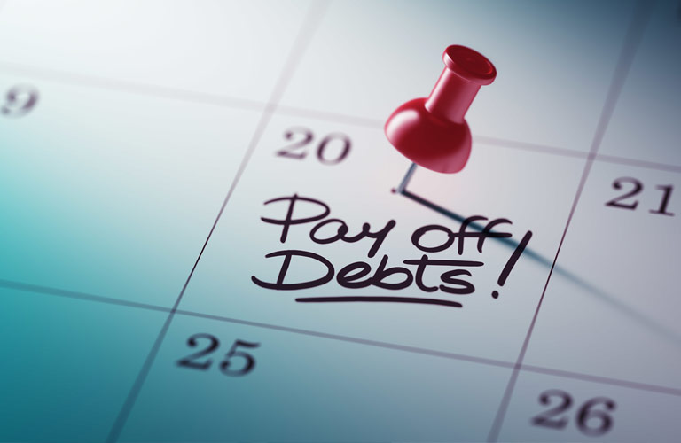
Figuring Out How Much You Owe
Step 1: Get organized.
Gather all account statements for all loans and debt obligations (mortgage, credit card statements, car loans, etc.).
Step 2: Add up your debts.
Add up the remaining balance on all statements to get your total debt.
Step 3: Access your credit report.
This report lists all your creditors and all the balances you owe.
Step 4: Compare the numbers.
They may not be exactly the same but they should be close.
Step 5: Compare your total debt.
Add up the remaining balance from your accounts listed on your credit report. This number should be the same as the one from your account statements. This number is your total debt.

Slide 8
Debt to Income Ratio
What is your Debt-to-Income Ratio?
How much you owe vs. how much you make
Measures your ability to make current debt payments
Step 1: Calculate your monthly debt
Step 2: Add up your total gross monthly income
Step 3: Divide your total monthly debt by your total monthly income
Monthly debt: | $
Monthly income: | $
Debt to income ratio: | ____%

Slide 9
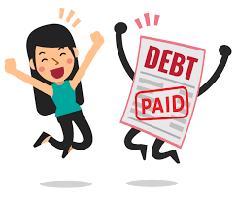
The Long-Term Strategy
Order your debts by the longest term (length) of the debt and pay off whichever will cost more throughout the length of the debt. Work your way from most expensive to least.
Goal: Pay the least amount over the course of years, rather than worrying about month-to-month costs. This should reduce the overall interest you pay.
The Long-Term Strategy & Credit Card Debt:
Paying credit card debt is a common example of the long-term strategy
The key to paying down credit card debt: Pay as much over the minimum as possible so your payment goes towards the principal rather than interest

Slide 10
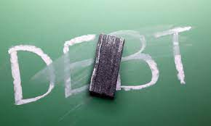
Interest-Rate & Month-to-Month Strategies
The Interest Rate Strategy:
Pay off the debts with the highest interest rates first, working your way from the bills with the highest rates to those with lower rates
Goal: Reduce the long-term effects of interest
The Month to Month Strategy:
Organize your monthly debts by whichever is easiest to pay off
Goal: Reduce the amount you pay each month
Note: This is a short-term fix for larger debt problems

Slide 11

The “Snowball” Technique
The Snowball Technique:
Once you pay off a debt in full, take the money you would have put towards paying that debt each month and apply it to a different debt.
Continue “snowballing” your debt payments until all debts are paid off.
The best way to pay off debts quickly!

Slide 12
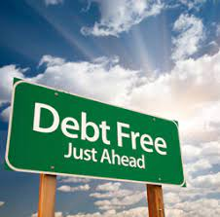
Additional Options for Paying Off Debt
Debt consolidation loan
Merging multiple loans into one – you make monthly payments to one lender and they pay off your existing debts
Taking out a second loan
Get a new loan and use that to pay off an old one
Credit counseling
Can help you to negotiate payments, fees, and interest rates with your creditors
Debt settlement
Negotiating with a creditor to reduce the amount of the principal you still owe
File for Bankruptcy
Petition in court for your debts to be discharged

Slide 13
Pros & Cons of Bankruptcy
BENEFITS
DRAWBACKS
Stops all collection actions by creditors
Most states exempt your home, car, and other essential assets
Can get you started on rebuilding your credit sooner
Can prevent your lenders from aggressive collection action
You will lose all your credit cards
You will likely lose luxury possessions
It will be nearly impossible to get a mortgage for 5 years
Stays on your credit report for 10 years, which can make it difficult to get a credit card or loan
Not all debts may be discharged in a bankruptcy

Slide 14
Action Plan for Paying Off Debts
Action Plan
 | Which Monthly Debt? | Payment Option: | When Will It Be Paid Off? | How Will It Be Paid Off?
1 | Credit card #1 | Long-term strategy + snowball technique | In 12 months | Pay over the minimum balance each month so the payment goes to the principal, rather than just interest. Once my credit card is paid off, I’ll put the money I would have paid each month for that bill towards my car loan.
2 | Car loan | Long-term strategy + snowball technique | In 18 months
3 | Credit card #2
4

Slide 15

Wrap-Up
Thank you all for your participation today!
Are there any questions?
Homework:
Choose one more money saving idea and commit to it for the week. Keep track of which ideas are going well and which are not.
Commit to using your personalized budget for the next week.

